Slide 1
The Traffic Sign Recognition and Training (TSRT)
Group 2

Slide 2
Team Member
Supervisor: Kiều Trọng Khánh
Mai Văn Tân
Bùi Việt Phong
Hồ Đắc Nghĩa (drop out)
Trần Lê Tuấn (drop out)

Slide 3
Outline:
Scenario Problem
Current solution
Propose our solution
Demonstration
Advantages and Disadvantages
Future Plan
Technology and development environment

Slide 4

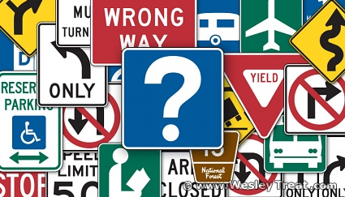
Scenario Problem

Slide 5
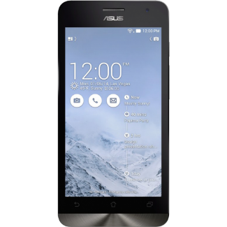

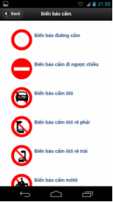

Current solution
- Accurate information
- Slowly
- Not update regularly
- Updated information
- Slowly
- Too many useless information
- Easy to user
- Slowly
- Few information

Slide 6

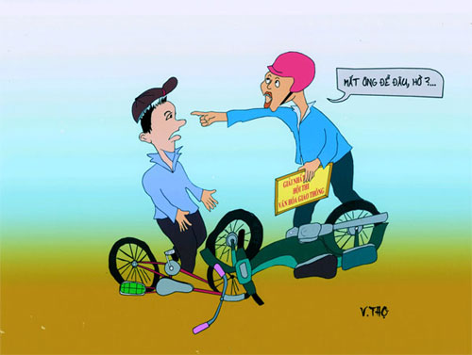

Ideas
Wi-Fi
3G
Smart phone has become cheap and popular.
3G network has developed rapidly in Vietnam with reasonable price.
People should have knowledge about traffic law.

Slide 7



Propose our solution

Slide 8
Features
Recognition
Application
Sync data
Learning
Training traffic sign

Slide 9
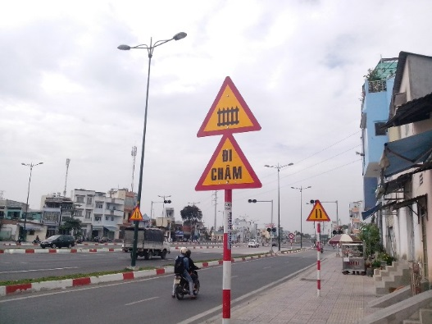
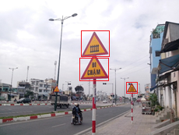
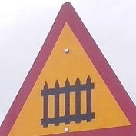
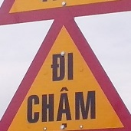

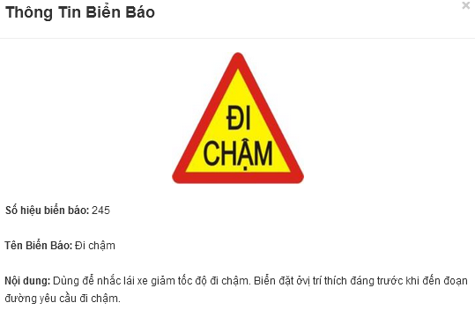
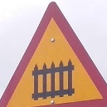

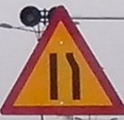
How detection and recognition work
Image
Detect
Detected Area
Start
Traffic sign
Recognize
Finish
210
245
203c

Slide 10
Definitions
Search auto: search traffic sign using image file or camera.
Train Image: Image use to train the system to recognize traffic sign (The more image to train, the higher accuracy).
Model: Data result of train process, use to recognize traffic sign.

Slide 11
Demonstration
Search auto in many conditions
Fix wrong recognize
Add new traffic sign (if any)
Sync favorite
Offline search

Slide 12

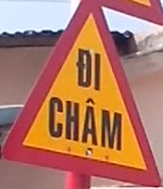
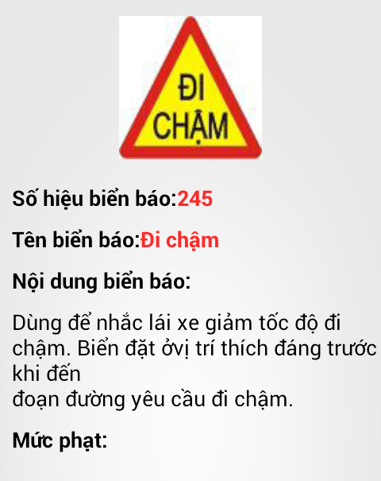

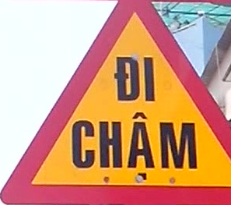
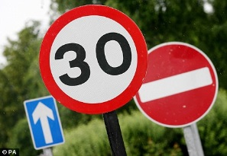
Search auto in many conditions

Slide 13



Fix wrong recognize
User’s report
System log

Slide 14



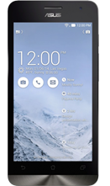

Sync favorite
+

Slide 15

Offline search

Slide 16
Advantages and Disadvantages
- Automatically
- Support learn
- The accuracy not reach 100%

Slide 17



Advantages and Disadvantages
Automatic
Learning
Accuracy not reach 100%

Slide 18
Future Plan
Support more platform (iOS, Windows phone)
Support more traffic sign types

Slide 19
Algorithms
Viola-Jones: Detect traffic signs
Reference:
http://en.wikipedia.org/wiki/Viola%E2%80%93Jones_object_detection_framework
SVM: Recognize traffic signs
Reference:
http://en.wikipedia.org/wiki/Support_Vector_Machine

Slide 20
Technology and development environment
http://bienbaogiaothong.tk

Slide 21
Thank you

Slide 22
Q&A

